Slide 1


Continuous Integration for SharePoint Projects with CruiseControl.NET and Coded UI Test
June 2012
Notes:
Course Review Committee:
Review Date:

Slide 2
Objectives
Understand continuous integration
Typical SharePoint application build process
Overview of Coded UI Test in Visual Studio 2010

Slide 3
Agenda
Continuous integration
Cruise Control.NET
Build Automation with CruiseControl.NET and NAnt
Coded UI Test in VS 2010
Demo

Slide 4
Continuous Integration
Notes:
Course Review Committee:
Review Date:

Slide 5
Continuous Integration
What’s continuous integration?
Benefits of continuous integration
What’s a build?
Build & deployment process

Slide 6
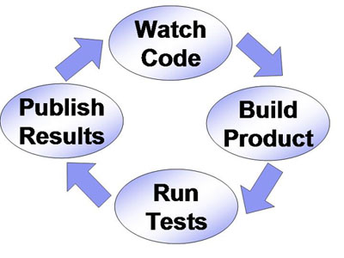
What’s continuous integration?
“Continuous Integration is a software development practice where members of a team integrate their work frequently, usually each person integrates at least daily - leading to multiple integrations per day. Each integration is verified by an automated build (including test) to detect integration errors as quickly as possible. Many teams find that this approach leads to significantly reduced integration problems and allows a team to develop cohesive software more rapidly.”
– Martin Fowler, Chief Scientist, Thoughtworks

Slide 7
Benefits of continuous integration
Automate the build
Eliminate human error
Faster feedback; minimize broken builds
Everyone can see what’s happening
Build/test reports
Code coverage reports
Minimize integration risk
Check in often; find problem early
Regular deploy and verify builds in Test Environment
Notes:
Building should take one action at most
Building should not take your time

Slide 8

What is a build?
Everything that needs to be done to get the application out the door
Get latest code
Compiling
Testing

Slide 9
Typical Continuous Integration Flow
The Flow
Bootstrap (setup)
Check for modifications
Run build (compile & package)
Run Unit Tests
Publish results
1
2
3

Slide 10
Cruise Control .NET
CruiseControl.NET is an Open Source Automated. Continuous Integration server, implemented using the .NET Framework.
Created by ThoughtWorks
The current version is 1.6 (Jan 2011)
Consist of a suite of applications:
CCNet server
WebDashBoard
CCTray

Slide 11
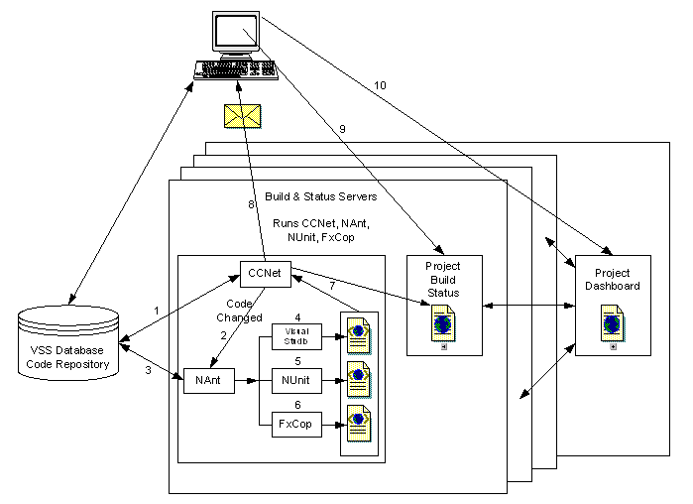
CruiseControl.NET Integration Process
Notes:
1. The CruiseControl.NET Server is started, and a project is started according to a Project Configuration Block in the Server's Configuration
2. CCNet checks the source code repository for modifications that have occurred since the last build attempt.
When modifications are detected
CCNet labels the project with CCNETUNVERIFIEDxxx (xxx = date/time) (Visual Source Safe only, optionally)
CCNet gets the latest version of the source from the source control repository
CCNet starts the build by executing the tasks in the <tasks> section of the ccnet.config file. In this example, the build will execute the <nant> task to run the NAnt build file.
3. NAnt processes the build script specified by the <nant> element . The following steps make up one possible scenario.
NAnt runs VS.NET using either the <exec> task or the <solution> task. The <solution> task provides better reporting capability for later steps.
NAnt runs NUnit using the <nunit2> task or the <exec> task
NAnt runs FxCop using the <exec> task
4. CCNet receives the outcome of the NAnt execution (Success/Failed)
If the build was successful, CCNet replaces the CCNETUNVERIFIEDxxx label with the next sequential build number. (VSS only)
The XML output files are gathered from each step using the File Merge Task and output as an xml file in the log directory specified in the <logDir> element.
5. CCNet sends out email based on the <publishers><email> elements in ccnet.config (Optional).
If <group notification="change"> is set, then the individuals will only receive email if the status of the build changes (Success -> Fail, or Fail -> Success)
If <group notification="always"> is set, then the individuals will receive email for every build.
6. CCTray displays current status of the build in the client system tray. The user can use the "Launch web page" menu item to browse to the build status website.
7. Project Dashboard enables multiple continuous integration projects to be viewed.

Slide 12
Using CruiseControl.NET with other applications
Source Control Systems: CVS, VSS, SVN ...
.NET Tools
Build tools
NAnt
Visual Studio .NET
MSBuild
Test, Coverage and Metric tools
NUnit
MSTest
Fxcorp
Ncover
Java Tools
Ant
JUnit

Slide 13
Cruise Control.NET server
The server application is the of Cruise Control.NET
Integration with a variety of source control (VSS, SVN…) and other external tool (NAnt, MSBuild, NUnit, FxCop…)
Build multiple projects on one server
Reporting: email, launch exe, RSS…

Slide 14
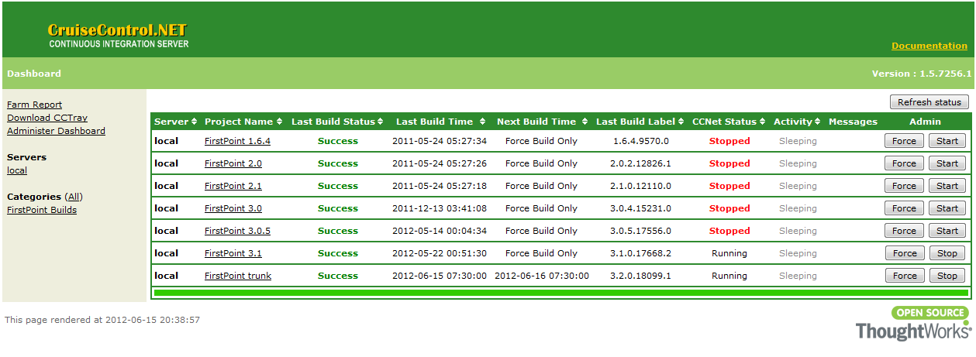
Web Dashboard
Web application
Report summary of all projects

Slide 15
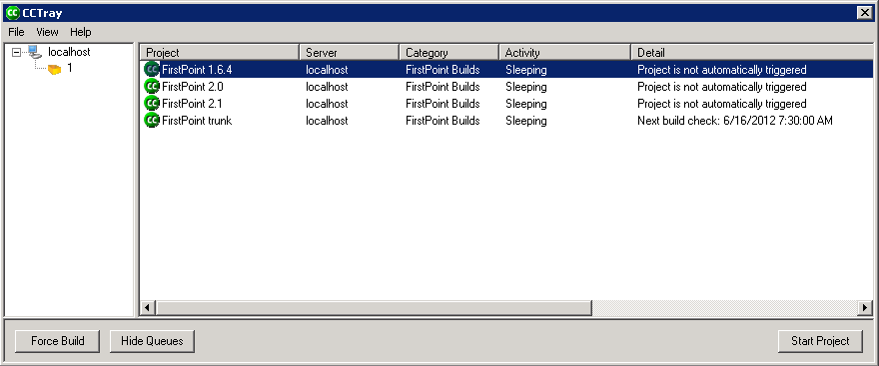
CC Tray
Client application
Enables to see “at a glance” the state of your projects from any machine on your network.

Slide 16
Typical SharePoint Application build process
Clean Up
Revert
Delete previous output
Pre-Build
Get latest code
Update build assembly
Update configuration file
Build
Build SharePoint solution, MSI project
Copy package, msi to output folder
Post-Build
SQL scripts (if need)
Documents (help & license)
Finish
Zip
FTP
Run Test
Tag Build
Deploy build to testing environment.
Code metric
Email

Slide 17
Building Application with CC.NET & NAnt
Notes:
Course Review Committee:
Review Date:

Slide 18
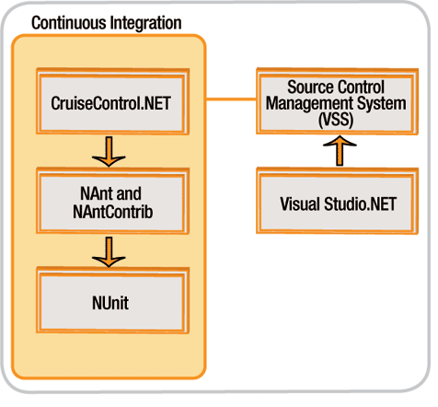
CC.NET NAnt Overview
NAnt is build tool
Build your source code and resource files into assemblies
NAnt Common Tasks
Get the latest source from source code control
Compile the code
Run unit tests
Create documentation from source code comments
Include non-code output files in the output of the build (images, .aspx files, configuration files, etc)
Package the output for deployment

Slide 19
Why use NAnt ?
Use its built-in support for CVS updates and checkouts to automatically get the latest source files
Use it to configure builds
Use it to compile .NET languages, including C#, VB.Net and J#
Use it's built in support for NUnit to automatically run unit tests
Use it's built in support for NDoc to automatically create documentation from source code comments (currently C# only)
Use it to copy non-code output files to the build directory
Use it to package builds into .zip files (or even .msi files) for deployment

Slide 20
NAnt Fundamentals
The basic concepts needed to understand and use NAnt
Running NAnt
Build Files
Projects
Targets
Tasks
Properties

Slide 21
Nant Fundamentals
Running NAnt
Download http://nant.sourceforge.net
Either you have to dump your scripts to C:\Nant folder or
Add the path (C:\Nant\bin) to your PATH environment variable.

Slide 22
Nant Fundamentals
Build Files
Build files are written in XML.
Each build file contains one project and a number of targets.
Each build file contains one project and a number of targets.

Slide 23
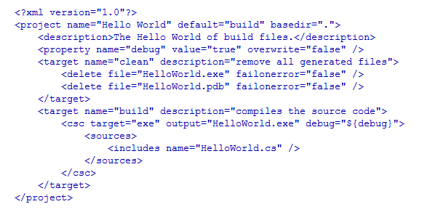
Nant Fundamentals
Build Files
In this example there are two targets, "clean" and "build". By default the "build" target will be called.

Slide 24
Nant Fundamentals
Projects
Attribute | Description | Required
name | The name of the project. | No
default | The default target to execute when no target is supplied on the command-line. | No
basedir | The base directory from which all path calculations are done. If not set, the parent directory of the buildfile will be used. | No

Slide 25
Nant Fundamentals
Targets
Attribute | Description | Required
name | The name of the target. | Yes
depends | A comma-separated list of names of targets on which this target depends. | No
if | An expression that should evaluate to true in order for this target to execute. | No
unless | An expression that, when evaluated to true, will cause the target to be skipped. | No
description | A short description of this target's function. | No

Slide 26

Nant Fundamentals
Dependencies Targets
execute the targets in the depends attribute in the order they appear from left to right

Slide 27

Nant Fundamentals
Wild Targets
A target can be marked as wild by setting the name attribute to "*". A build file can contain up to one wild target, and it is executed if and only if the invoked target does not exist in the current build file. Wild targets let you define how to handle invalid requests, or provide generic behavior for unknown targets. For example:

Slide 28
Nant Fundamentals
Conditional Execution
A target also has the ability to perform its execution if or unless a property has been set. This allows, for example, better control on the building process depending on the state of the system (OS, command-line property defines, etc.). To make a target sense this property, you should add the if or unless attribute with an expression that the target should react to. For example:.

Slide 29
Nant Fundamentals
Tasks
a piece of code that can be executed.
<name attribute1="value1" attribute2="value2" ... />
Task Reference

Slide 30
Nant Fundamentals
<unzip>
Extracts files from a zip file.
Attribute | Type | Description | Required
zipfile | file | The archive file to expand. | True
encoding | Encoding | The character encoding that has been used for filenames inside the zip file. The default is the system's OEM code page. | False
todir | directory | The directory where the expanded files should be stored. The default is the project base directory. | False
failonerror | bool | Determines if task failure stops the build, or is just reported. The default is true. | False
if | bool | If true then the task will be executed; otherwise, skipped. The default is true. | False
unless | bool | Opposite of if. If false then the task will be executed; otherwise, skipped. The default is false. | False
verbose | bool | Determines whether the task should report detailed build log messages. The default is false. | False
<unzip zipfile="backup.zip"/>

Slide 31
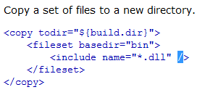
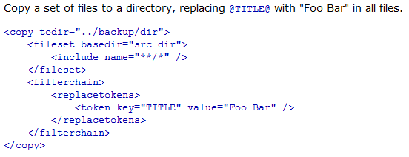
Nant Fundamentals
<copy>
Copies a file or set of files to a new file or directory.

Slide 32
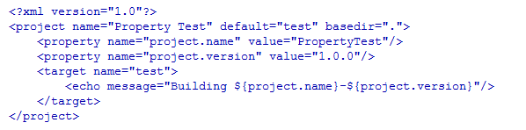

Nant Fundamentals
Properties
A project can have a set of properties.
These might be set in the buildfile by the <property> task, or might be set outside NAnt.
A property has a name and a value. Properties may be used in the value of task
Individual build files can then use this property:

Slide 33
Visual Studio 2010 Coded UI Test
Notes:
Course Review Committee:
Review Date:

Slide 34
Visual Studio 2010 Coded UI Test
Visual Studio 2010 Coded UI Test
Introduction
Features Benefits
Framework Model
How to configure Test Controller and Test Agent
How to configure Coded UI Test with Test Agent
Capture Object
Test Suite
Module
Test Case
Report
Demo

Slide 35
Introduction
Visual Studio 2010 Coded UI Test
A hybrid framework which supports keyword driven and data driven concepts.
A framework that wraps complex internal architecture components and makes them easy to use to the end user

Slide 36
Features Benefits
Visual Studio 2010 Coded UI Test
Test Suites/Test Cases is reusable
Easy to develop and maintain scripts
UI is friendly and easy to use to run and view report
Less effort for test cases/ test suites execution report

Slide 37



Framework Model
Visual Studio 2010 Coded UI Test
Automation Test Engineer
Input Data Excel File
(Test_Suite.xls and Test_Case.xls)
Common Libraries
Capture Objects
Visual Studio 2010
Function to call test suite to execute
Log File
(Log.txt)
Report File
(Test_Report.xls)

Slide 38
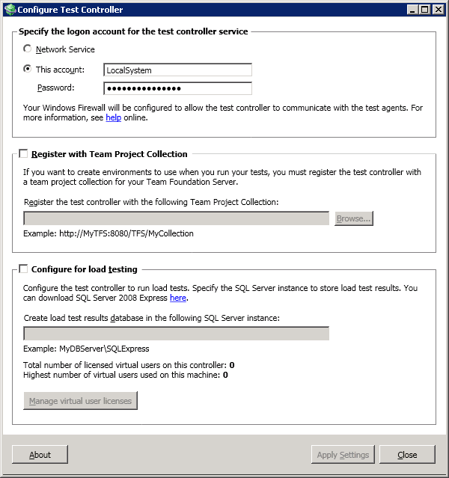
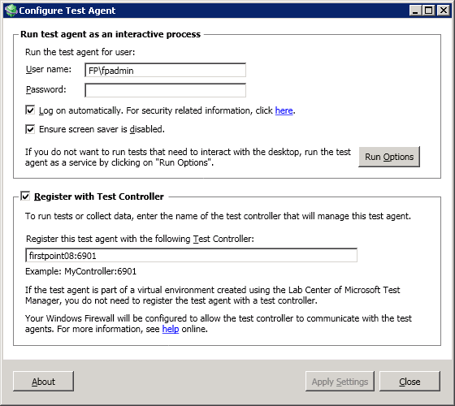
How to configure Test Controller and Test Agent
Visual Studio 2010 Coded UI Test
Start \ Programs \ Microsoft Visual Studio 2010
In the Configure Test Controller dialog, click Apply Settings
In the Configure Test Agent dialog, enter controller name and port into Register with Test Controller text box, click Apply Settings

Slide 39
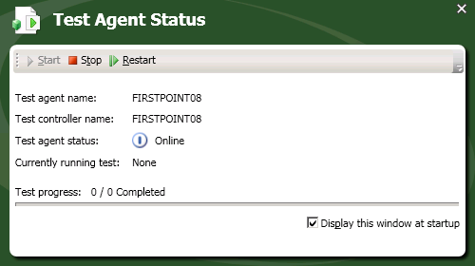
How to configure Test Controller and Test Agent (cont.)
Visual Studio 2010 Coded UI Test
Test Agent status will change from Disconnect to Online

Slide 40
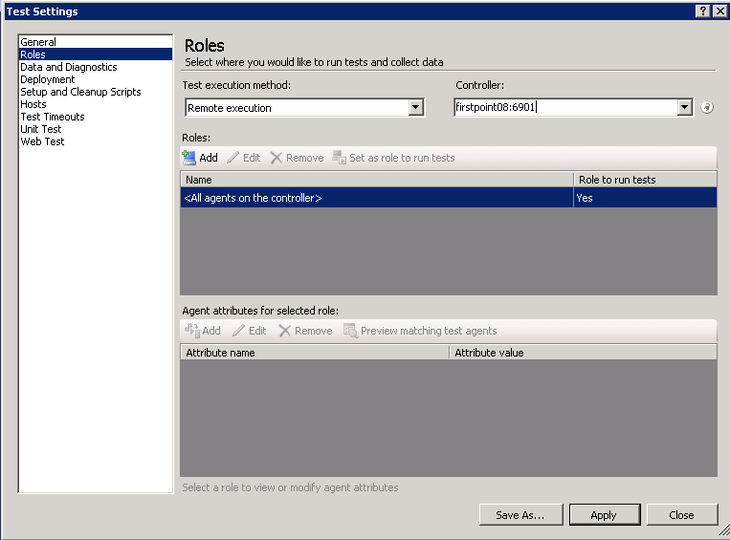
How to configure Coded UI Test with Test Agent
Visual Studio 2010 Coded UI Test
Open Visual Studio 2010
Create new Test project
Open Local.testsettings
Select Remote execution
Enter agent name and port to Controller
Click Apply

Slide 41
How to configure Coded UI Test with Test Agent (cont.)
Visual Studio 2010 Coded UI Test
Create bat file
cd C:\CodeUITest\TestFP\bin\Debug
"C:\Program Files (x86)\Microsoft Visual Studio 10.0\Common7\IDE\MsTest.exe" /testcontainer:TestFP.dll /category:FPConfiguration /runconfig:C:\CodeUITest\Local.testsettings
Execute bat file with Cruise Control .NET
<exec>
<executable>run_codedui.bat</executable>
<baseDirectory>C:\Build</baseDirectory>
<buildTimeoutSeconds>0</buildTimeoutSeconds>
</exec>

Slide 42
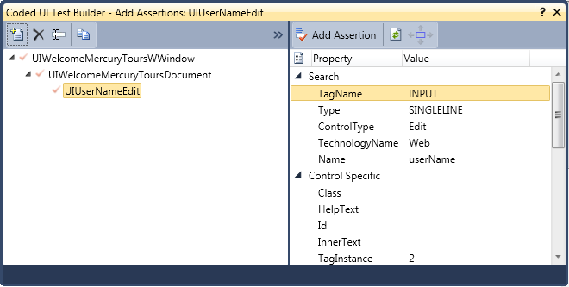
Capture Object
Visual Studio 2010 Coded UI Test
Use Coded UI Test Builder to recognize application controls as edit box, button, combo box, check box…
Coded UI Test Builder
Application Under Test

Slide 43
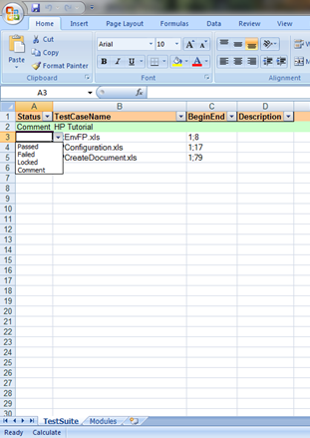
Test Suite
Visual Studio 2010 Coded UI Test
Test Suite is a collection of test cases that are intended to test a software application or a module/component
Has 4 columns:
Status: Passed/Failed; Locked; Comment
Test Case Name: enter test case file name
Begin;End: system will run test case from begin row to end row as identified
Description: will be set with error lines number when test case execution is completed and fails to work
Notes:
Status: include 4 values:
Passed/Failed: will be set automatically when test case execution is completed
Locked: system will not run test cases marked “Locked”
Comment: detail description for each test case and system will skip rows marked “Comment”
Test Case Name: enter test case file name
Begin;End: system will run test case from begin row to end row as identified
Description: will be set with error lines number when test case execution is completed and fails to work

Slide 44
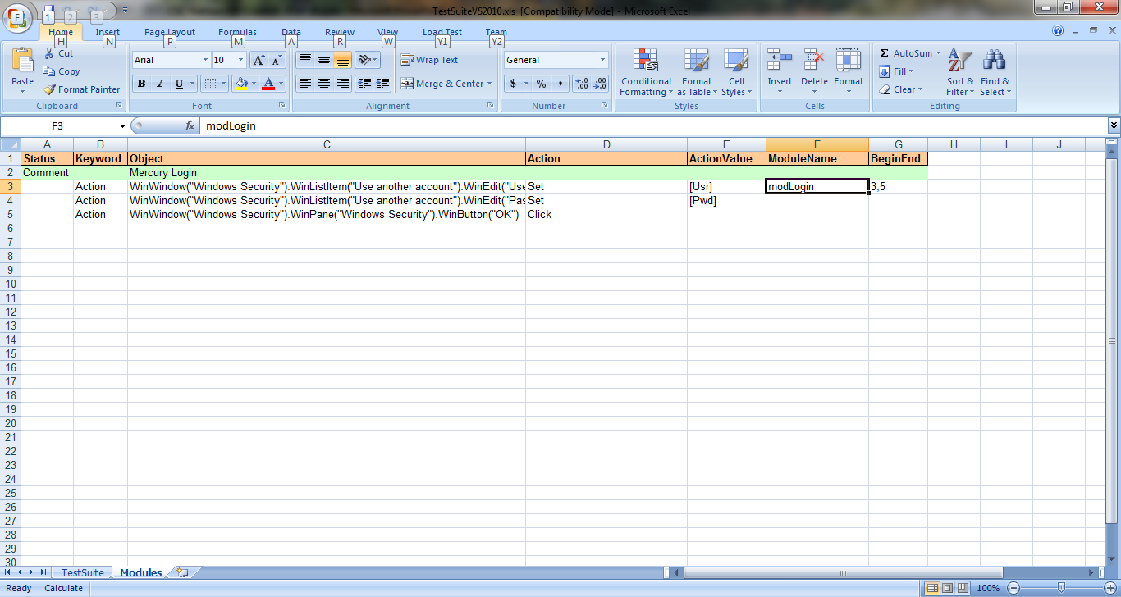
Module
Visual Studio 2010 Coded UI Test
Module sheet consists of repetitive actions used in the test case
Has 7 columns:
Status: include 4 values:
Passed/Failed: will be set automatically when test case execution is completed
Locked: system will not run test cases marked “Locked”
Comment: detail description for each test case and system will skip rows marked “Comment”
Keyword:
Action
Function
Object: depends on Keyword column
Action:
Contains methods available to the chosen object if Action is selected
Empty if Function is selected
Parameter: specifies parameters or values needed for the current step
Module name: will be used in test case to make a call to a module.
Begin;End: begin row and end row of a module

Slide 45
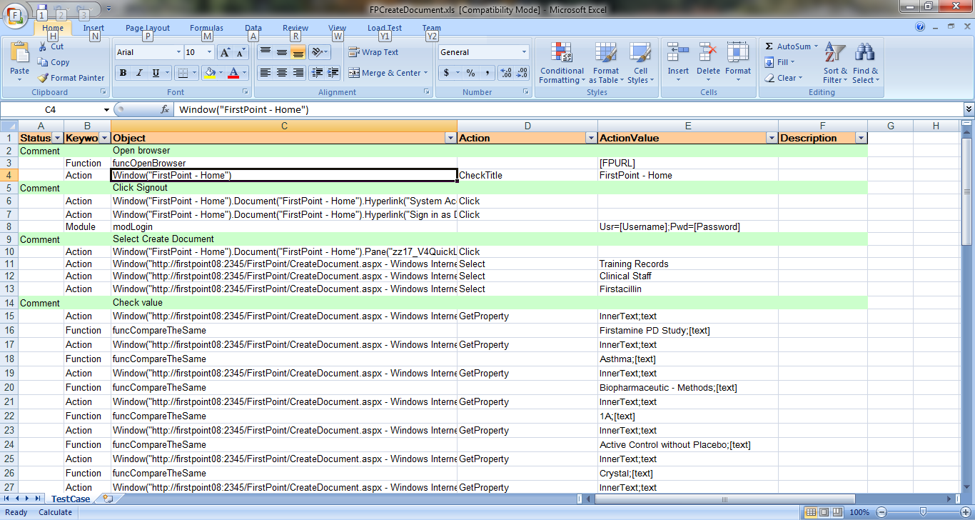
Test Case
Visual Studio 2010 Coded UI Test
Test Case is a set of conditions or variables which a tester will determine whether an application or software system is working as expected or not.
Has 6 columns:
Status: has 4 values:
Passed/Failed: will be set automatically when test cases execution is completed.
Locked: system will not execute test steps marked “Locked”
Comment: detail description for each step and system will skip rows marked “Comment”
Keyword: has 4 values:
Action
Module
Function
TestCase

Slide 46
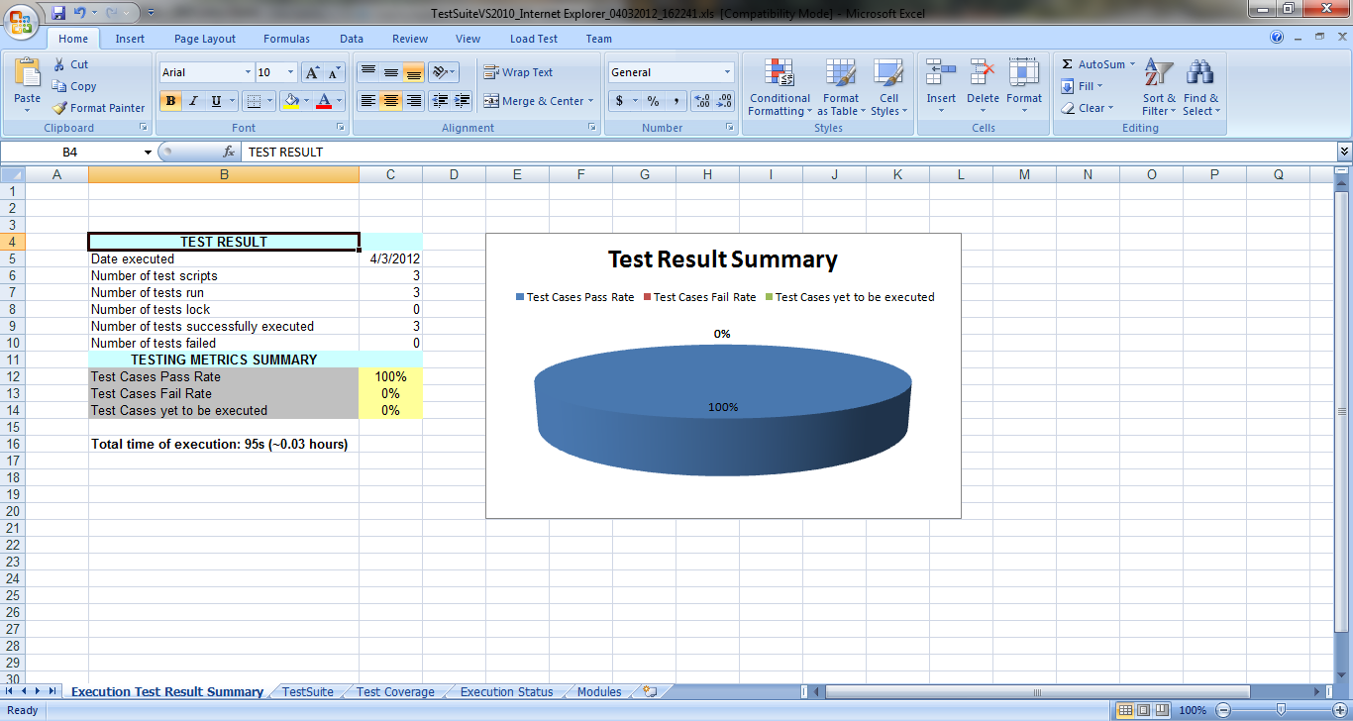
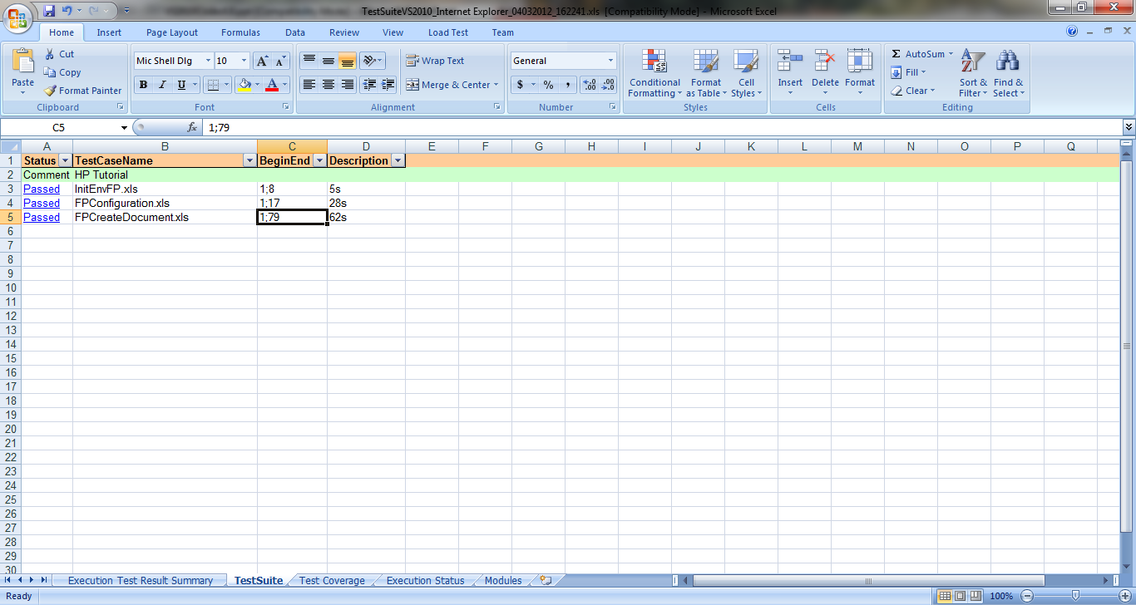
Report
Visual Studio 2010 Coded UI Test
After test cases execution is completed, system will create Temp folder (if not existed) to store Excel Reports. This folder can be changed by modifying/setting Tools>Options
In Report folder, system will create files as below
TestSuite_ddMMyyyy_hhmmss.xls
TestCaseName_ddMMyyyy_hhmmss.xls
LogFileName_ddMMyyyy_hhmmss.xls

Slide 47
Demo

Slide 48
Build flow chart
Visual Studio 2010 Coded UI Test
Get latest build from FPT Server
Update data via SQL scripts
Install Services, Admins Sites, MDS,…
Replace the configure files
Delete related data from SQL Server
User PowerShell to create SP Sites
Import best practices
Add User – Groups permission via PS
…
Run Coded UI Test

Slide 49
Q&A
Notes:
Course Review Committee:
Review Date:

